Slide 1
Shell Bootcamp 2024 3 Reflections for Week 1
<Name>
Date : 30-Aug-2024

Slide 2

About Me
“Do the best you can until you know better. Then when you know better, do better.”
- Maya Angelou
Please share an image / visual that best represents you

Slide 3

My learnings from this week! – Soft skills

Slide 4
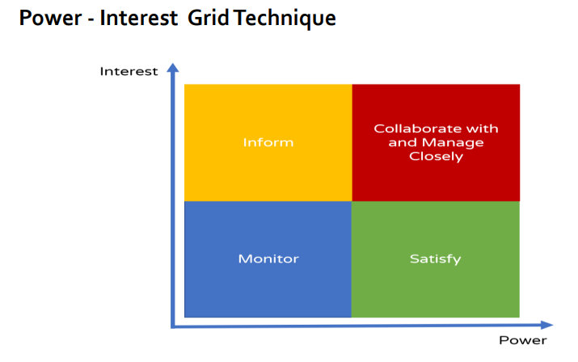
Learning 1 | My takeaways
Please share (in your own words) details of the learning.
Stakeholder Management
It is important in actively identifying, engaging, and communicating with all stakeholders
It can help me balancing conflicting interests and in crisis management.
[Add a graphic that provides evidence of what you learned]

Slide 5
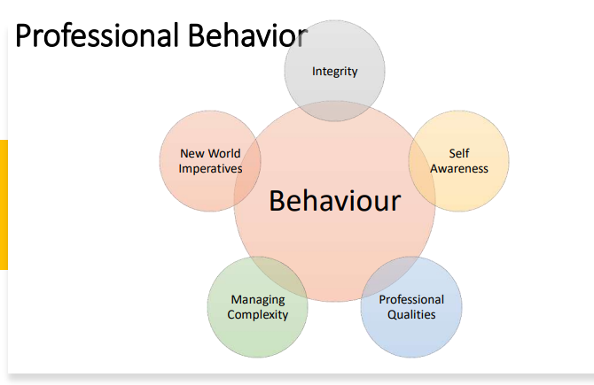
Learning 2 | My takeaways
Please share (in your own words) details of the learning.
Professionalism
A professional is a person who is engaged in a specified activity as one's main paid occupation rather than as an amateur.
It taught me how to conduct myself and act with integrity and stakeholder engagement.
[Add a graphic that provides evidence of what you learned]

Slide 6
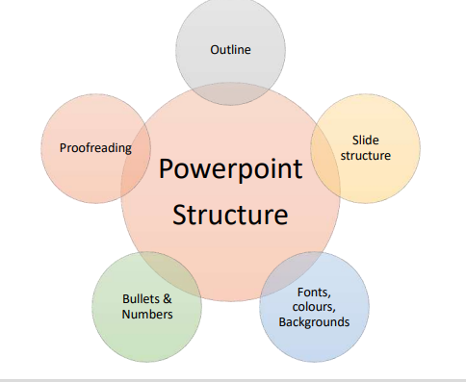
Learning 3 | My takeaways
Please share (in your own words) details of the learning.
Presentation Skills
Presentation is a way of communicating ideas and information to a group. Presentations are an important part of corporate life.
It can help me in:-
AUDIENCE ANALYSIS
CONTENT and DESIGN
DELIVERY
[Add a graphic that provides evidence of what you learned]

Slide 7

Relevance of learnings for my organization

Slide 8
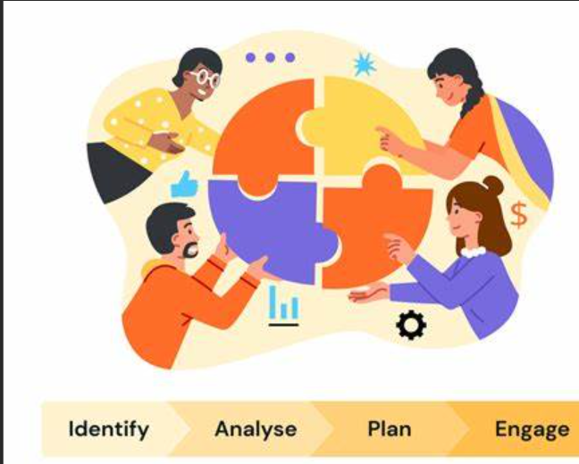
Learning 1 | Relevance for Shell
How I feel Shell implements this learning (in your own words)
Effective stakeholder Management is how Shell ensures that the interests, needs, and concerns of stakeholders are understood and addressed, fostering collaboration, reducing risks, and increasing the likelihood of project success.
[Add a graphic that provides view of how Shell implements this learning]

Slide 9

Learning 2 | Relevance for Shell
How I feel Shell implements this learning (in your own words)
In an industry, where the environmental and social impacts of operations are closely scrutinized, professionalism is essential to maintaining trust, improving operational efficiency, and ensuring long-term success.
[Add a graphic that provides view of how Shell implements this learning]

Slide 10

Learning 3 | Relevance for Shell
How I feel Shell implements this learning (in your own words)
Presentation skills will help me to effectively communicate complex information, engage stakeholders, lead teams, secure project approvals and promote innovation.

Slide 11

Challenges in implementing learning

Slide 12
Challenge faced while implementing Learning 1
While doing a role play on Stakeholder Management, one of the key challenge we faced was navigating conflicting interests while also trying to make progress.

Slide 13
Challenge faced while implementing Learning 2
In our role play on professionalism, one of the key challenges was upholding ethical standards and professional behavior in the face of difficult situations. Handling pressure while staying composed and making sound, ethical decisions can test professionalism.

Slide 14
Challenge faced while implementing Learning 3
When we did a presentation, main challenge was to effectively communicating complex information in a clear and engaging way. Ensuring that content is understandable to a diverse audience with varying levels of expertise can be difficult.

Slide 15
Thank You

